Slide 1





SALES & PROFIT PERFORMANCE
YASH NIVAS NAIK

Slide 2

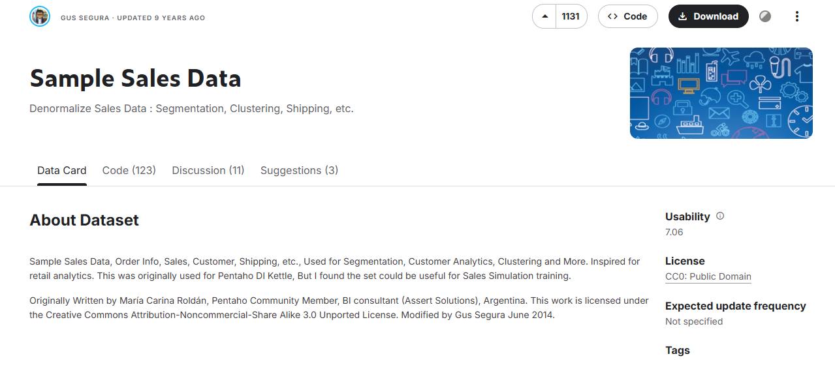

THE
DATASET
https://www.kaggle.com/datasets/kyanyoga/sample-sales-data
The dataset is rich in features for detailed customer and geographical sales analysis, containing a total of 25 columns. It covers key numerical metrics such as SALES and QUANTITYORDERED, temporal dimensions (ORDERDATE, YEAR_ID), and extensive categorical data for segmentation, including PRODUCTLINE, DEALSIZE, and specific customer contact details.

Slide 3


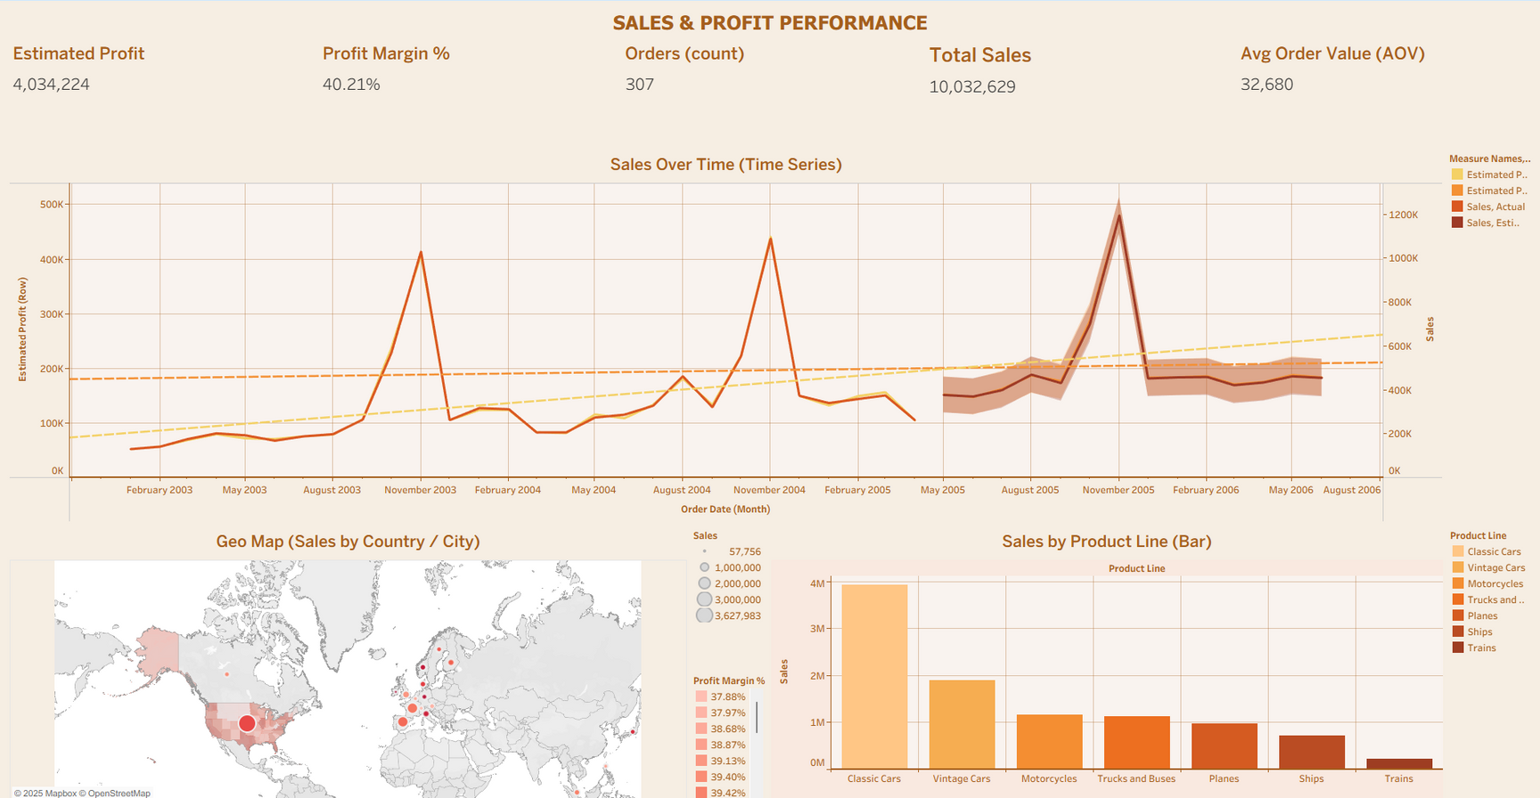
DASHBOARD
THIS FINANCIAL SUMMARY SHOWS A DATASET WITH A 40.21% PROFIT MARGIN AND AN AVERAGE ORDER VALUE (AOV) OF $32,680. THE TIME SERIES INDICATES VOLATILE ACTUAL SALES OVER THE ANALYSIS PERIOD (2003–2006), BUT A GENERALLY UPWARD TREND IN ESTIMATED PROFIT. THE GEOGRAPHIC AND PRODUCT-LINE BREAKDOWNS CLEARLY IDENTIFY THE MAJOR SALES DRIVERS (CLASSIC CARS AND THE US MARKET).

Slide 4

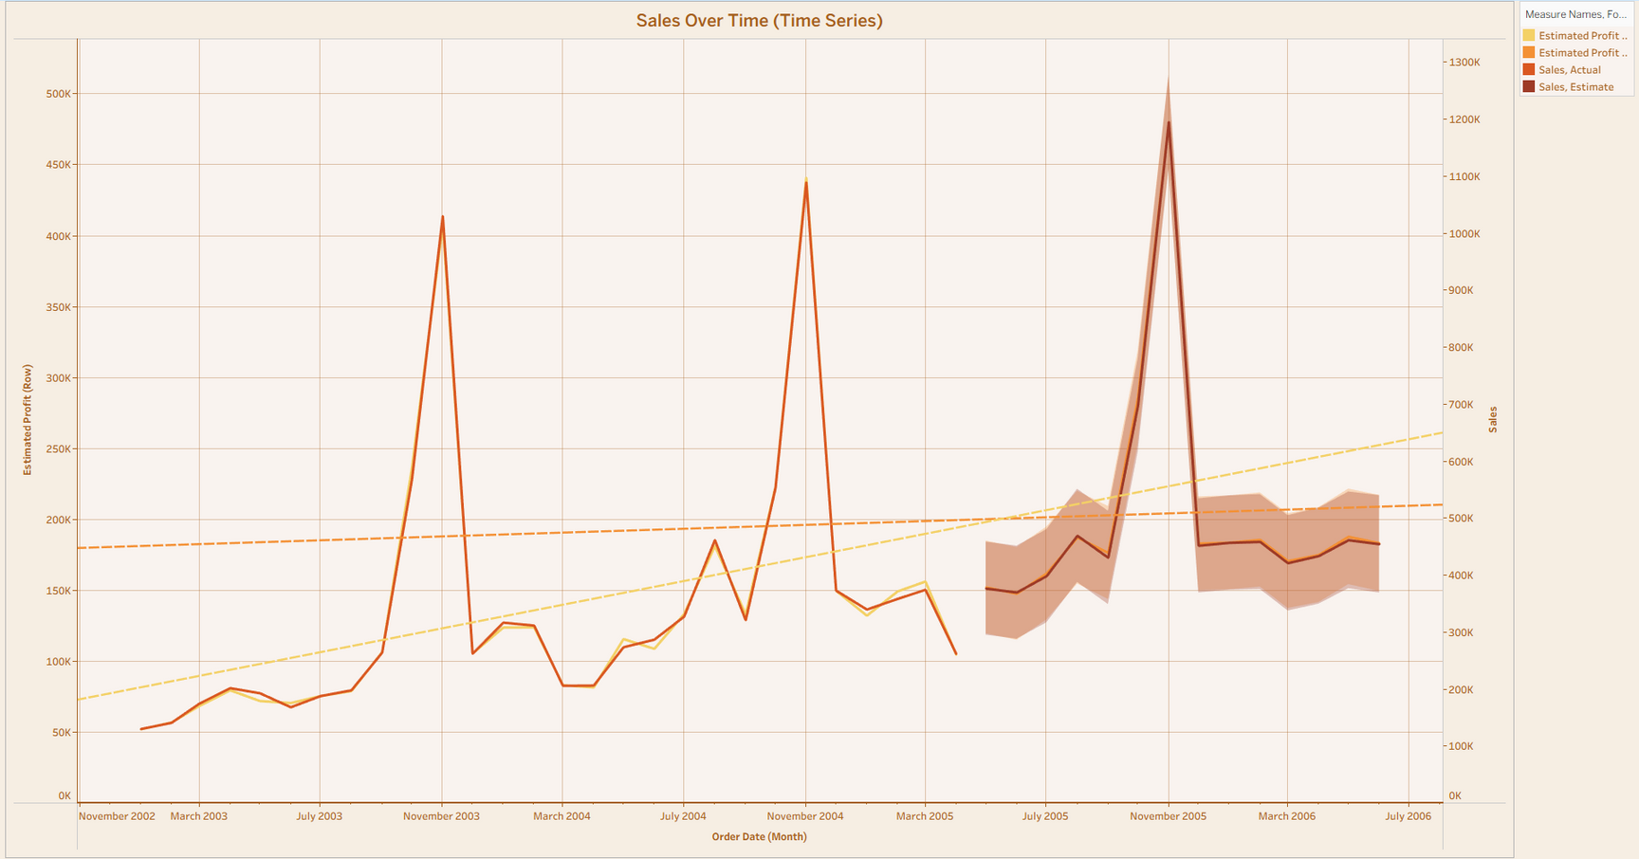

THE VISUALIZATION HIGHLIGHTS PERIODS OF HIGH SALES VARIABILITY, PARTICULARLY A MAJOR SPIKE IN LATE 2005 WHERE ACTUAL SALES EXCEEDED 1.2 MILLION, AND INDICATES THAT THE ACTUAL PROFIT GENERALLY TRACKS THE ESTIMATED PROFIT, THOUGH THE DIFFERENCE BETWEEN THEM (THE SHADED AREA) WIDENS DURING AND AFTER THE 2005 PEAK.

Slide 5
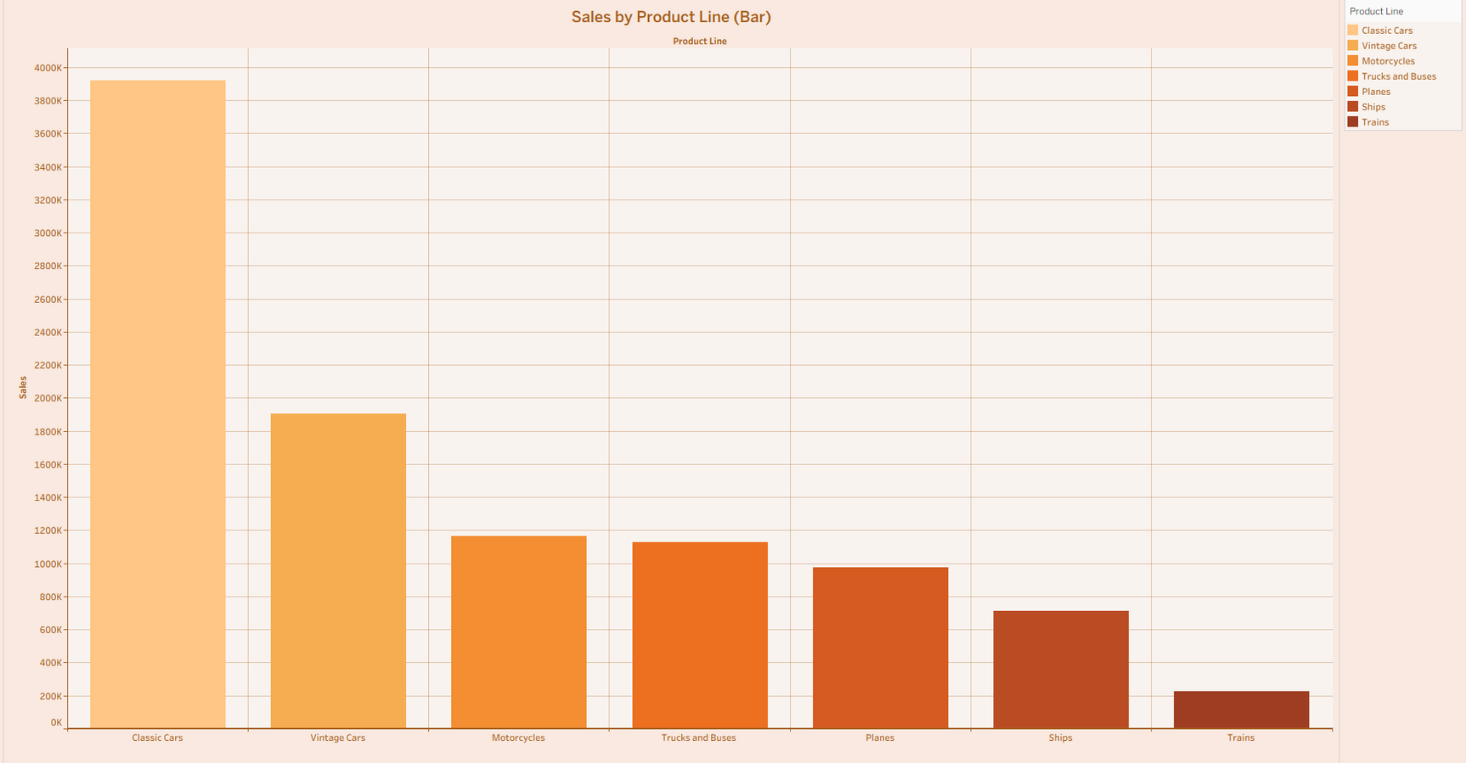

THIS BAR CHART RANKS THE SALES PERFORMANCE BY PRODUCT LINE, SHOWING THAT CLASSIC CARS ARE THE TOP-SELLING PRODUCT LINE BY A LARGE MARGIN, WITH SALES APPROACHING 400,000.

Slide 6
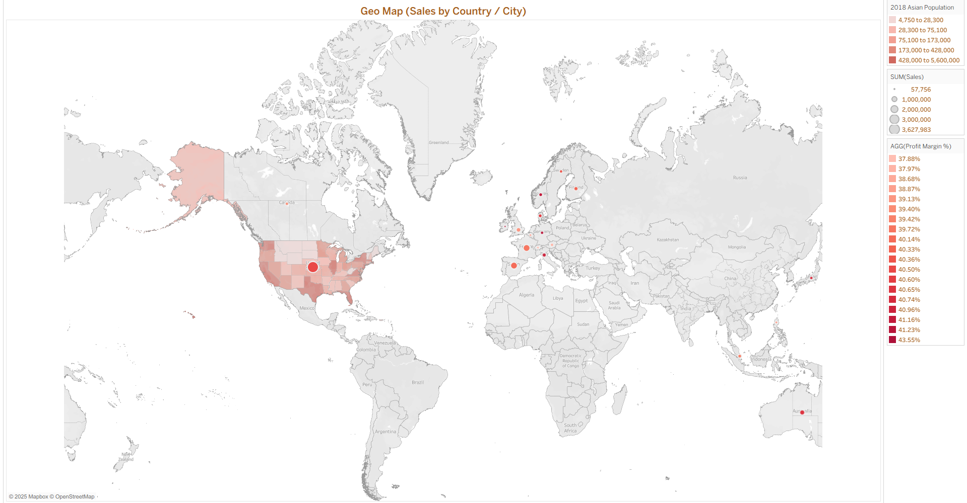

THE MAP REVEALS THAT SALES ARE HIGHLY CONCENTRATED IN NORTH AMERICA AND EUROPE, WITH THE COLOR INTENSITY (RED HUES) INDICATING HIGH SALES VOLUME IN MAJOR US CITIES AND VARIOUS EUROPEAN COUNTRIES, WHILE OTHER CONTINENTS SHOW MINIMAL RECORDED SALES.

Slide 7


THANK
YOU

